Slide 1
INTRODUCTION OF PHYSIOLOGY
Dr. A. K.Dwivedi
(H.O.D)

Slide 2
CONTENTS
DISCOVERY BY DIFFERENT SCIENTIST
WORD MEANING OF PHYSIOLOGY
INTRODUCTION OF PHYSIOLOGY
HISTORY
PHYSIOLOGY IS A PRECLINICAL SUBJECT
ROLE OF PHYSIOLOGY IN THE STUDY OF HOMOEOPATHY

Slide 3
CELLS
TISSUE
ORGANS AND ORGAN SYSTEM

Slide 4
DISCOVERY OF DIFFERENT SCIENTIST
William Harvey
Ivan Petrovich Pavlov
Claude Bernard
Thomas Hunt Morgan

Slide 5
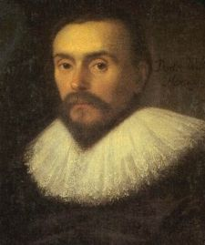
WILLIAM HARVEY
Born | April 1, 1578 Folkestone
Died | June 3, 1657
Nationality | English
Fields | physician
Doctoral advisor | Hieronymus Fabricius
Known for | systemic circulation
Father of Physiology.
Discoverer of Circulatory System.
Research in Embryology.

Slide 6
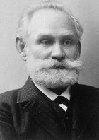
IVAN PETROVICH PAVLOV
Born | September 14, 1849 Ryazan, Russia
Died | February 27, 1936 Leningrad, Soviet Union
Residence | Russian Empire, Soviet Union
Nationality | Russian, Soviet
Fields | Physiologist, psychologist, physician
Known for | Transmarginal inhibition Behavior modification
Notable awards | Nobel Prize in Physiology or Medicine
Physiology of the Pancreatic Nerves.
Physiology of the Digestion.
Theory of Reflexes.

Slide 7
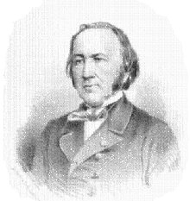
CLAUDE BERNARD
Born | July 12, 1813 Saint-Julien
Died | February 10, 1878
Nationality | France
Fields | physiology
Institutions | Muséum national d'Histoire naturelle
Known for | physiology
Discoverer of Glycogenic Function of the Liver.
Work in the Pancreas and its role in digestion.
Work of Sympathetic Nervous System.

Slide 8
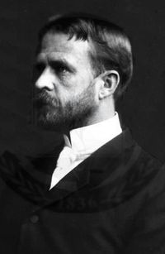
Thomas Hunt Morgan
Born | September 25, 1866 Lexington, Kentucky
Died | December 4, 1945 (aged 79) Pasadena, California
Nationality | United States
Fields | geneticist embryologist
Doctoral students | John Howard Northrop
Notable awards | Nobel Prize in Physiology or Medicine in 1933
Theory of Gene.

Slide 9
physiology
Phys i·ol·o·gy [fìzzee ólləjee]
noun
study of the functioning of living things: the branch of biology that deals with the internal workings of living things, including such functions as metabolism, respiration, and reproduction, rather than with their shape or structure
body’s internal processes: the way a particular body or organism works
[Mid-16th century. Via French physiologie or Latin physiologia from Greek phusiologia , from phusis “nature” (see physics) + -logia “-logy.”]

Slide 10
Introduction
The term physiology originated from a Greek root Physiologikos meaning discourse on natural knowledge. It was introduced by the French physician Jean Fernel in 1552. Physiology deals with the normal functioning of the body.

Slide 11
The purpose of a course of physiology is to teach the functions, processes and Interrelationship of the different organs and systems of the normal body disturbance and diseases and to equip the student with normal standards of reference for use while diagnosing and treating deviation from the normal. To a Homoeopath the human organism is an integrated whole of body life and mind; and though life includes all the chemico-physical processes it transcends them. There can be no symptoms of disease without vital force which is deranged in diseased person. Physiology shall be taught from the stand point of description physical processes underlying them in health.

Slide 12
    There are different kind of subjects –
Preclinical-
Anatomy
Physiology
Pharmacy
Organon of Medicine (Philosophy)
Clinical-
Obstetrics and Gynaecology
Surgery
Practise of Medicine
Para clinical
Pathology
Preventive and Social Medicine
Repertory

Slide 13
Physiology (physis – nature; logos – discourse ) literally means knowledge of nature. The term belongs to an era when physiology and philosophy were not much different. But now physiology means the study of the function of living organisms. It is difficult and usually unnecessary for one person to study the function of all living organisms. Accordingly a student chooses to study viral physiology, bacterial physiology, plant physiology, animal physiology or human physiology. Medical physiology concentrates on human physiology. However a man is unmistakably similar to animals, and a lot of human physiology has been learnt from animals. Therefore medical physiology is based to a very large extent on animal physiology.

Slide 14
HISTORY
The term physiology {physis, nature ; logos , discourse was used by the Greeks as a synonym for natural philosophy {philein, to love ; Sophia ,wisdom}.A student of nature has to be a lover of wisdom! According to George Sarton , the first “physiologist” of the world, in this sense, was Thales of Miletos, a Greek philosopher who lived around 600 BC.
The first “physiologist” of the world, in the modern sense, was William Harvey (1578-1657). He was the student of Fabricius, a great teacher of Anatomy at Padua, Italy. Fabricius was the successor of Vesalius, whose textbook of Anatomy marked the beginning of the European Renaissance. But the term ‘physiology’ was used in its modern sense half a century after Harvey’s death.

Slide 15
The term physiology was first used for describing the science of body function by Herman Boerhaave (1660-1738), a physician at Leyden, Holland, in his book Institutiones Medicae in 1708. He also established physiology as an independent discipline in the medical curriculum. One of his best known pupils, Albrecht von Haller (1708-1777) wrote the first textbook of physiology, Elementa Physiologiae, in 1757.By the middle of the 19th century there were two leading schools of physiology in Europe: The French school led by Francois Magendie (1783-1855) and the German school led by Johannes Muller (1801-1858) and Carl Ludwig (1816-1895). Magendie founded the first journal devoted exclusively to physiology.

Slide 16
His most distinguished pupil, who surpassed the teacher, was Claude Bernard (1813-1878). Claude Bernard propounded the concept of milieu interieur or internal environment and established physiology as the scientific basis of medicine. The concept of constancy of the internal environment was further elaborated by the American physiologist Walter Cannon who also coined the term homeostasis to describe this constancy. Muller’s student Herman Helmholtz (1821-1894), who also surpassed his teacher, was as good at physics as physiology. He formulated the law of conservation of energy, invented the ophthalmoscope, propounded a theory of colour vision, and did some fundamental work on the physiology of hearing. Ludwig, who invented the kymograph, settled at Leipzig, where he developed an institute of physiology which was for many decades the mecca of students of physiology from all parts of the world.

Slide 17
Physiology is a preclinical subject
In physiology we deals with the normal function of the
Cells
Tissue
Organs
System &
Organisms (whole body)

Slide 18
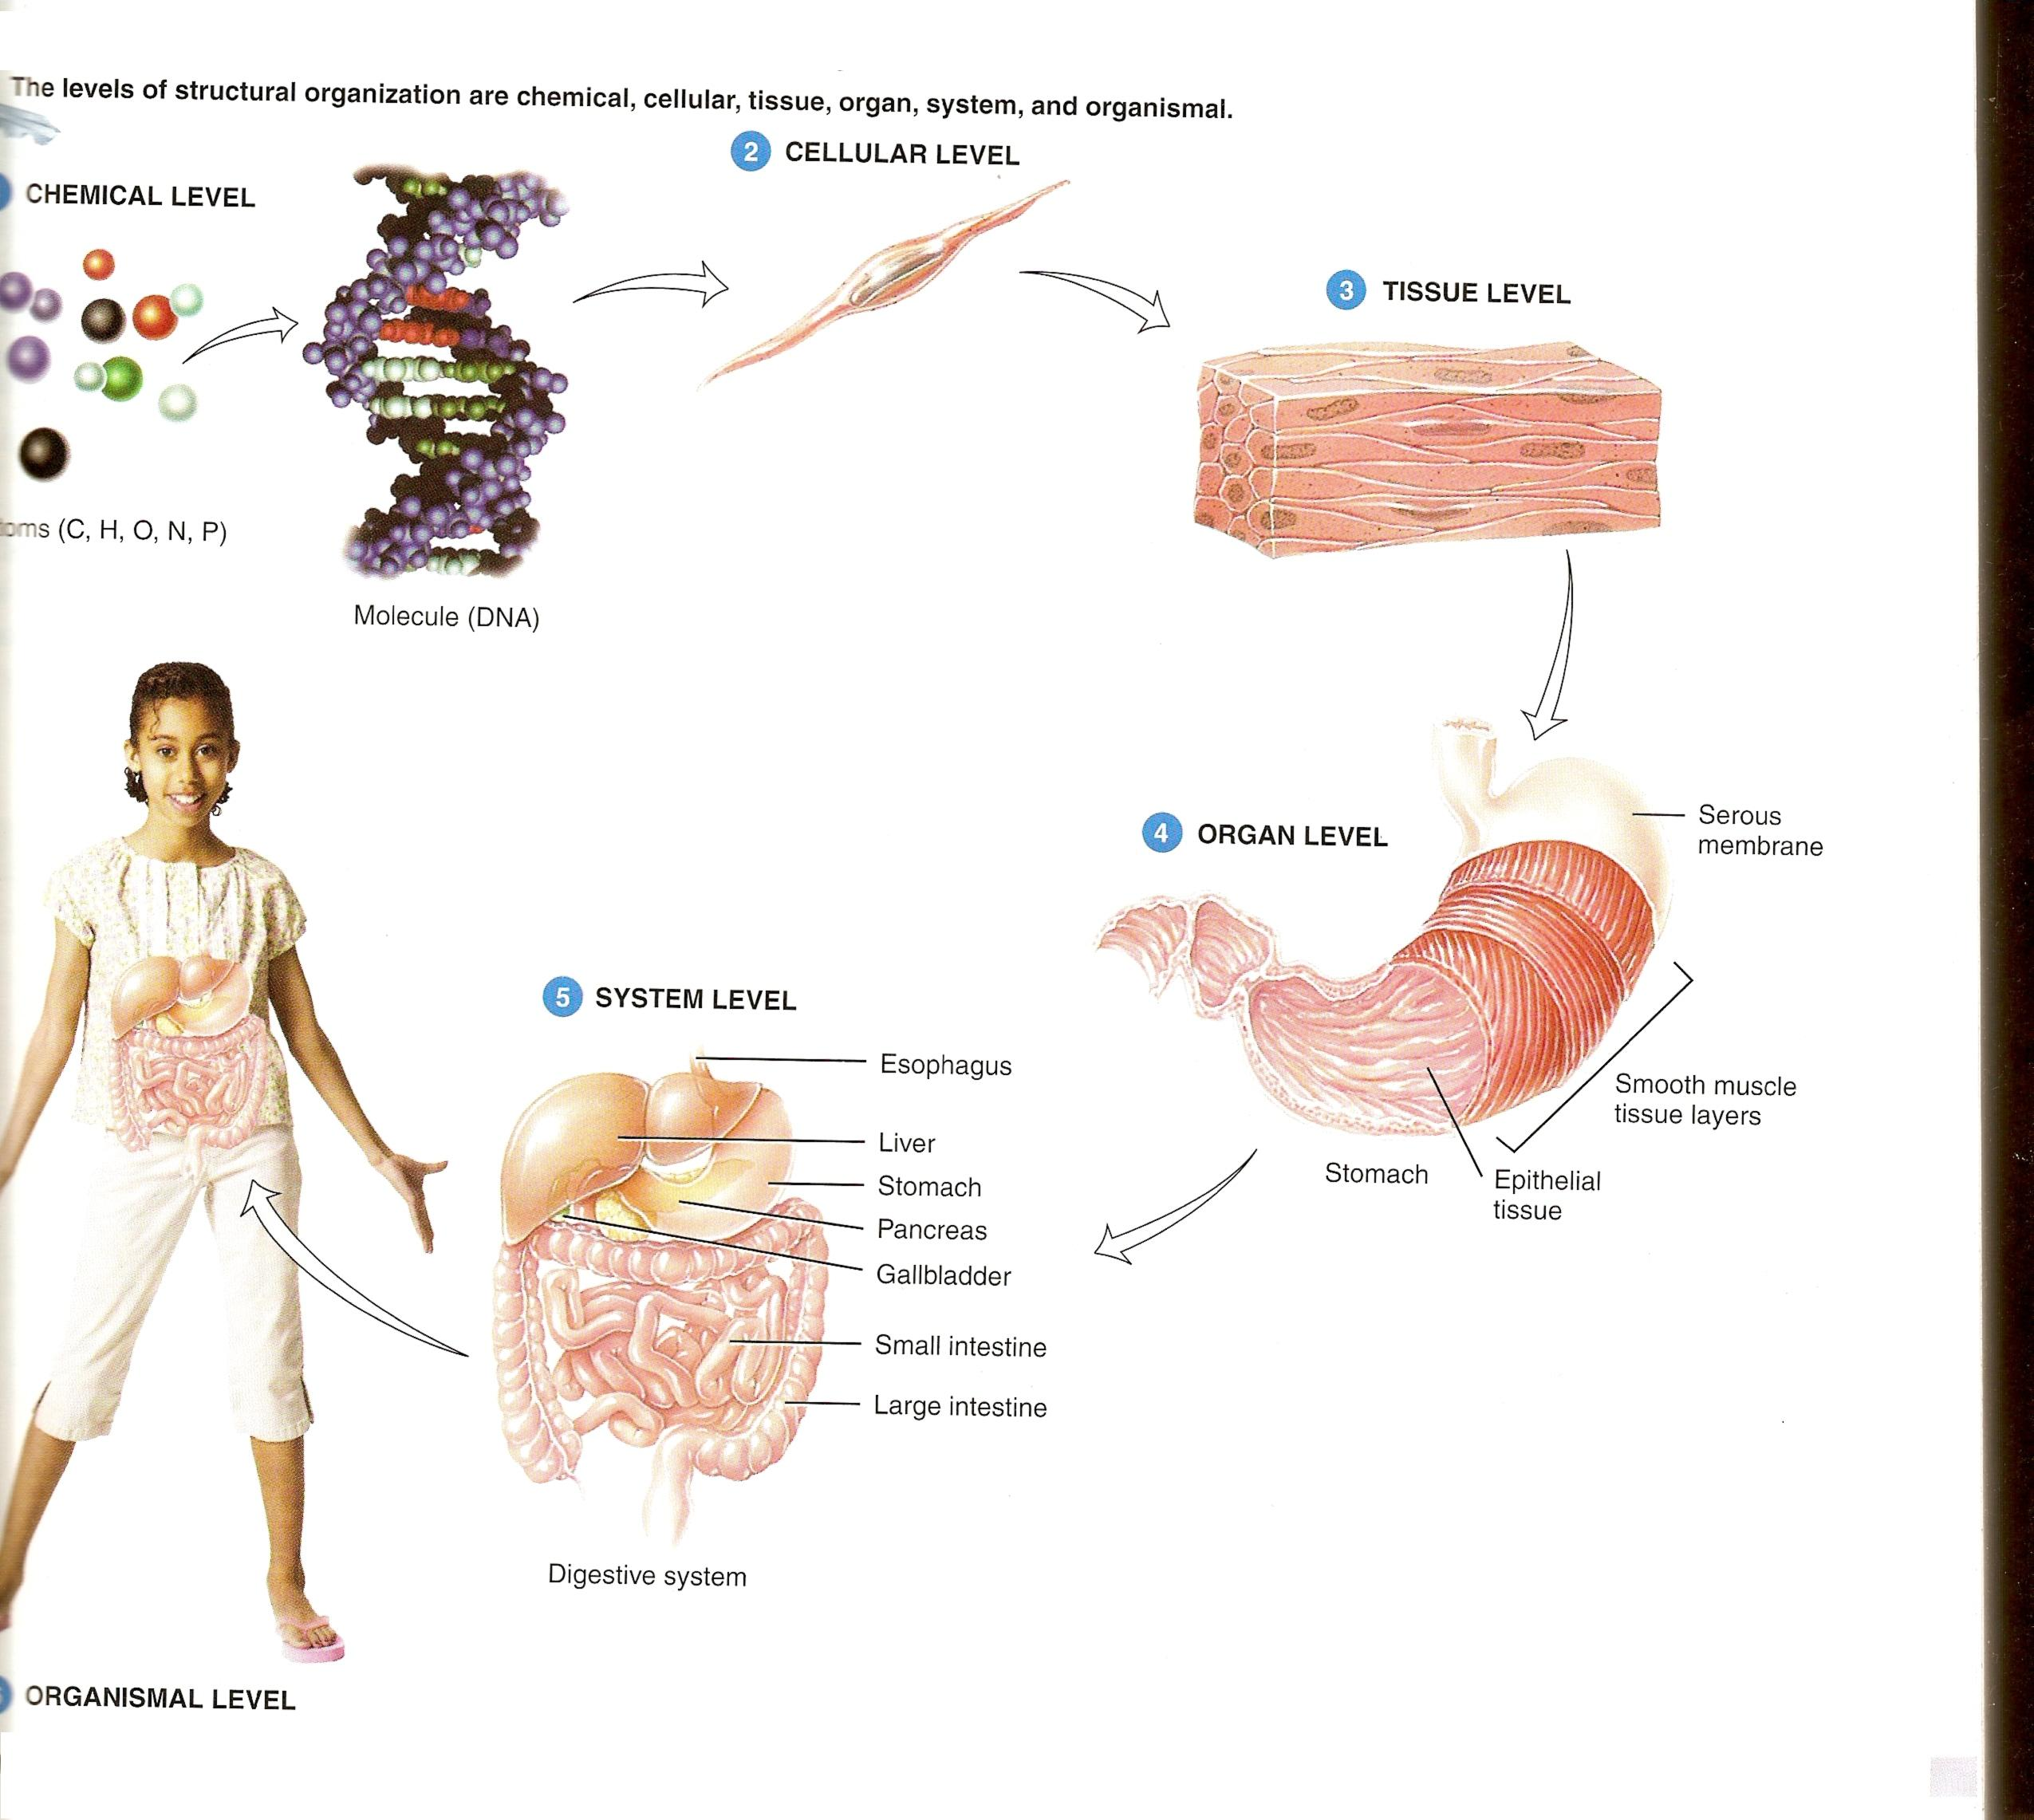

Slide 19
Role of Physiology in the study of Homoeopathy
Without the knowledge of normal of anything / anybody-
We can not say whether it is abnormal or it is diseased.
In physiology we study the normal standard with which we can compare the present status or condition of the patients – symptoms / pathological values etc.
Human organisms is integrated whole of body and mind
For becoming a Homoeopathic Physician we must know thorough knowledge of Physiology because
The knowledge of drug is not sufficient to cure the particular case i.e. mental or physical symptoms of particular drug.

Slide 20
To find
what a drug is
from where it is obtained
how it is prepared for medicinal use
how it act upon human organisms (body)
what tissues it especially act upon
how it affects them
how much of the drug should be applied (or given)
to arouse the symptoms to produce certain results
what are its characteristics therapeutics
A special study of the physiological action of each drug has been made for drug pathology is necessary for scientific physician.

Slide 21
A special study of the physiological action of each drug has been made for drug pathology is necessary for scientific physician.
At prima fascie physiology help us in knowing normal than abnormal which help in diagnosing the particular disease.
Thing in the world has soul and each soul need material body to animate itself that mean each living thing has its special property it may be physiological or pathological property through which it get affected faster.

Slide 22
Each and every medicine has its own physiological action from where it have to start
ABCD of Homoeopathy medicine in relation to Physiology
Aconite – central nervous system
Belladonna – circulation
Chamomilla – excessive acidity
Digitalis – increased B P
Eucalyptus – chronic catarrh of bladder
Ferrum – well marked anaemia
Glonine –vaso motor paralysis
Hamemalis – phlebitis, varicosis, haemorrhage
Ignatia - hyperaesthesia , spasm
Jaborandi – cardiac dropsy

Slide 23
Kali bich – dyspnoea
Lachesis – distressed sleep
Merc sol – easily bleeding ulcers
Nux vomica – gray matter of spinal cord
Opium – intense congestion
Phytolacca – sexual, mamme
Rhus tox – sero fibrous tissue affection
Secale cor – abortifacient
Sulphur – lymphatic's, deodorizing
Thuja – tubercles, condylomata
Urtica urens - increased secretion of milk
Veratrum – watery diarrhoea, chloraic vomiting
Zinc mett - headache, melancholia

Slide 24
Form aconite to zinc mett all medicine have their physiological action from above to downward. Each and every medicine has its physiology and pathology.
If we don’t know its normal how could we know abnormal so first of all physiology, is important than its pathology, than its prognosis.
This is competitive & challenging world all people believe on written proof by any authorized pathology.

Slide 25
Patient
Its Physiology
Pathology
Prognosis
Complete totality
Disease daignosis
Remedy

Slide 26
This conclude that physio-pathology all are the extremities of homoeopathy because without it we doesn’t have any proof.

Slide 27
THE TISSUE LEVEL
OF
ORGANIZATION

Slide 28
CONTENTS
Word meaning
Definition
Different types of tissues
Location
Function

Slide 29
Word meaning
HISTOLOGY(hiss’-TOL-o-je; histo = tissue; -logy = study of) so the word histology means the study of tissues.
DEFINITION
A tissue is a group of similar cells that usually have common embryonic origin and functions together to carry out specialized activities.

Slide 30
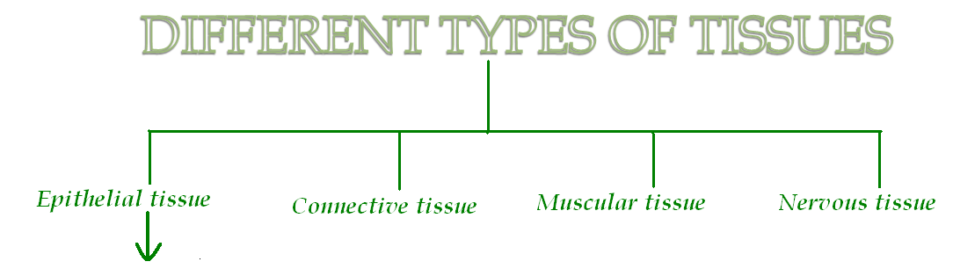

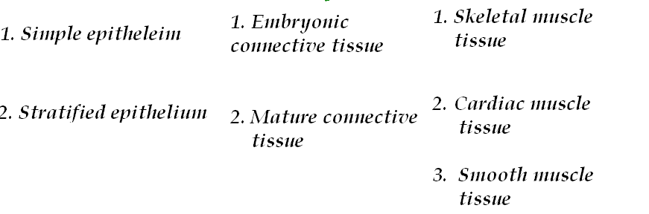

Slide 31
A. SIMPLE SQAMOUS EPITHELIUM
Description :- Single layer of flat cells; centrally located nucleus.
Location :- Lines heart, blood vessels, lymphatic vessels, air sacs of lungs, glomerular (Bowman’s) capsule of kidneys, and inner surface of the tympanic membrane (eardrum); forms epithelial layer of serous membrane, such as the peritoneum.
Function :- Filtration, diffusion, osmosis, and secretion in serous membranes.

Slide 32
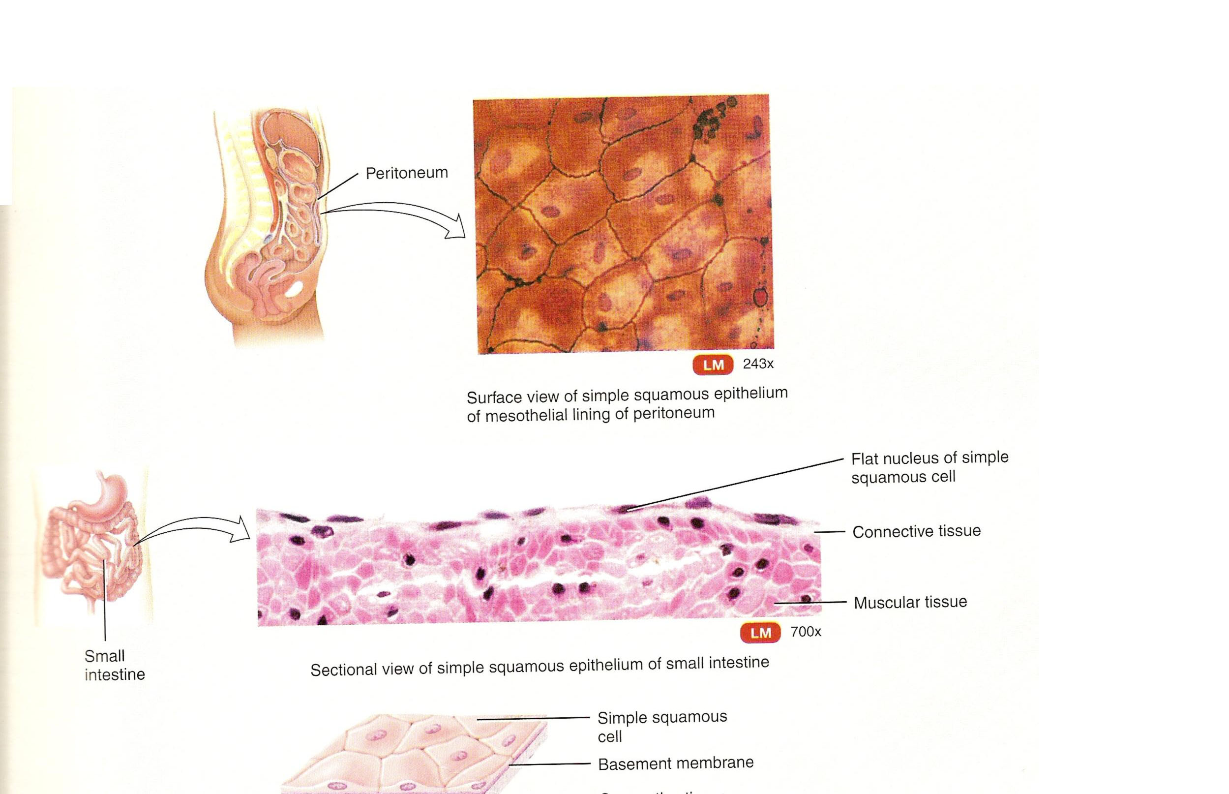
SIMPLE SQUAMOUS EPITHELIEUM

Slide 33
B. SIMPLE CUBOIDAL EPITHELIUM
Description :- Single layer of cube-shaped cells; centrally located nucleus.
Location :- Covers surface of ovary, lines anterior surface of capsule of the lens of the eye, forms the pigmented epithelium at the posterior surface of the eye, lines kidney tubules and smaller ducts of many glands, and makes up the secreting portion of some glands such as the thyroid gland and the ducts of some glands such as the pancreas.
Function :- Secretion and absorption.

Slide 34
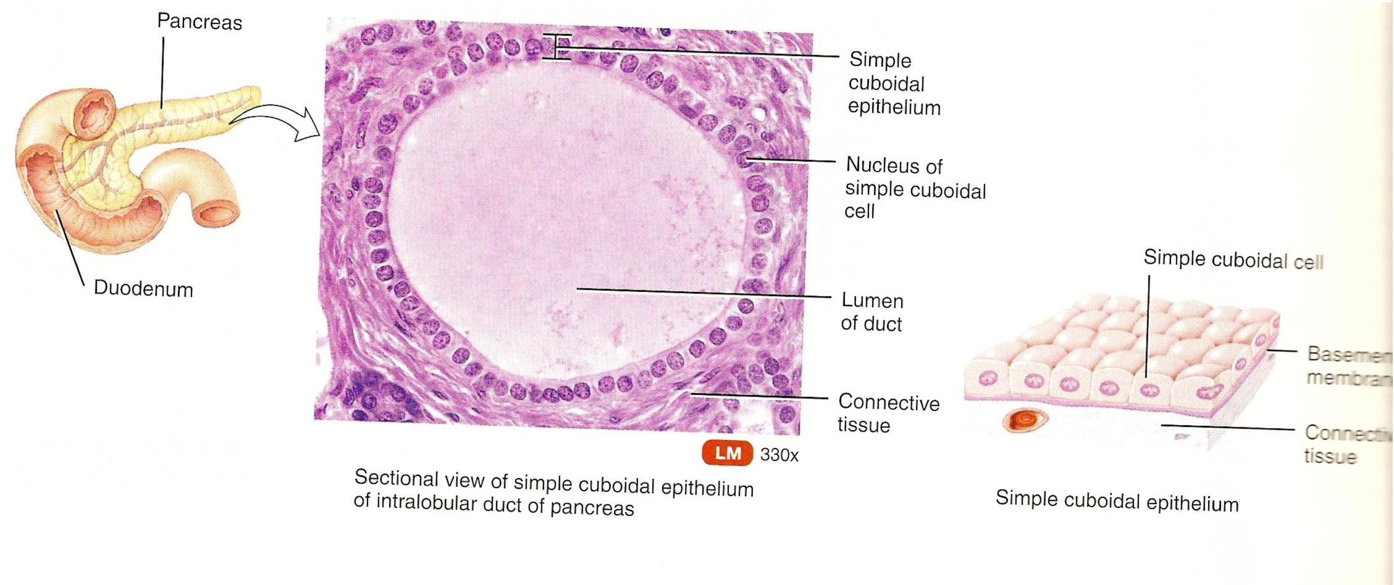
SIMPLE CUBOIDAL EPITHELIUM

Slide 35
C.NONCILIATED SIMPLE COLUMAR EPITHELIUM
Description :- Single layer of nonciliated column-like cells with nuclei near base of cells; contains goblet cells and cells with microvilli in some locations.
Location :- Lines the gastrointestinal tract(from the stomach to the anus), ducts of many glands, and gallbladder.
Function :- Secretion and absorption.

Slide 36
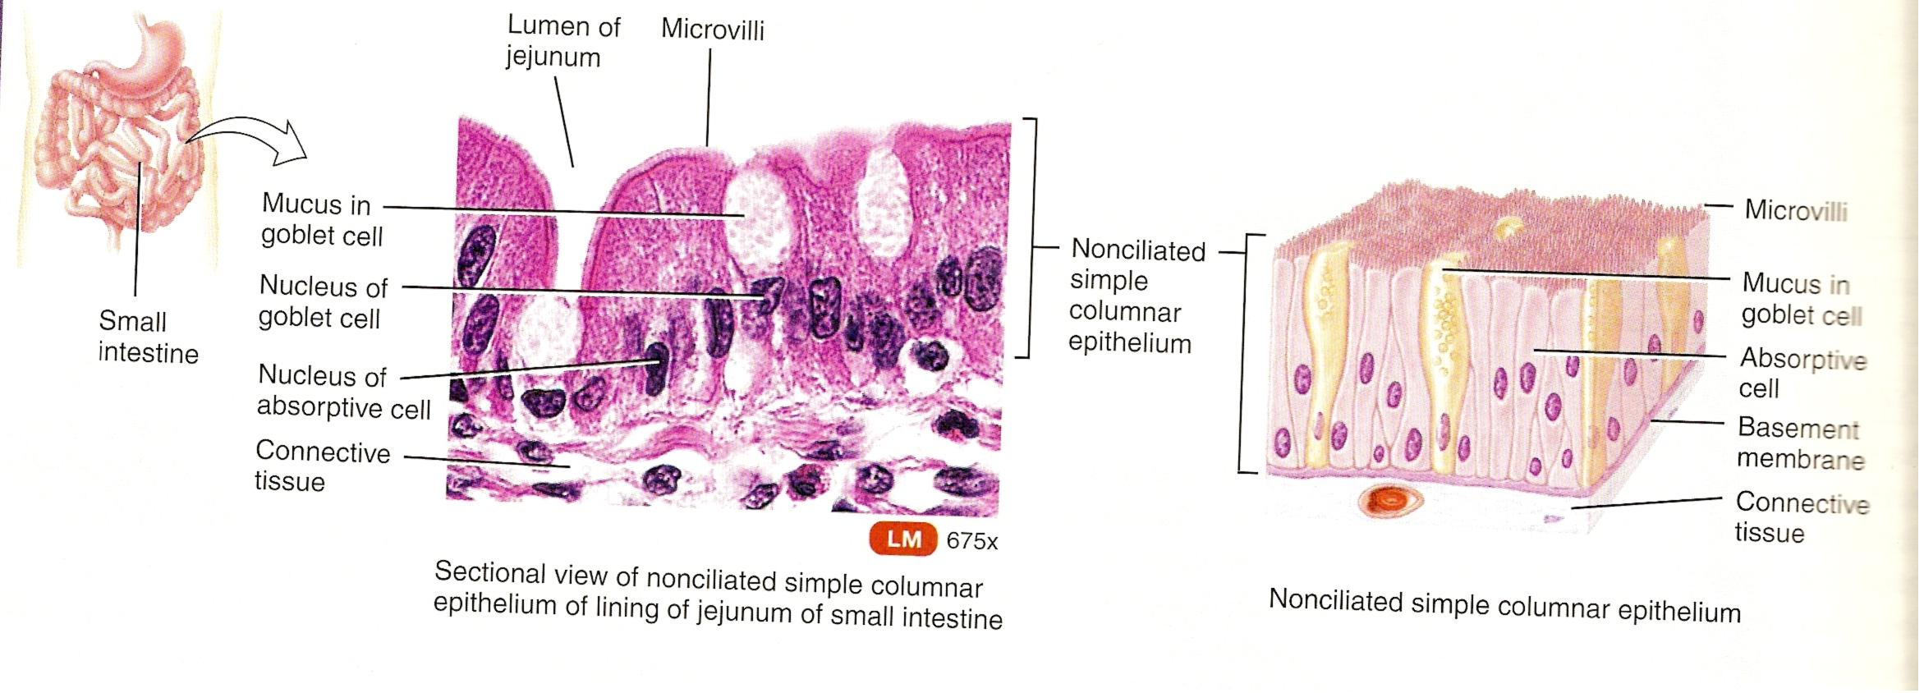
NONCILIATED SIMPLE
COLUMNAR EPITHELIUM

Slide 37
D. CILIATED SIMPLE COLUMNAR EPITHELIUM
Description :- Single layer of ciliated column-like cells with nuclei near base; contains goblet cells in locations.
Location :- Lines a few portions of upper respiratory tract, uterine(fallopian) tubes, uterus, some paranasal sinuses, central canal of spinal cord, and ventricles of the brain.
Function :- Moves mucus and other substances by ciliary action.

Slide 38
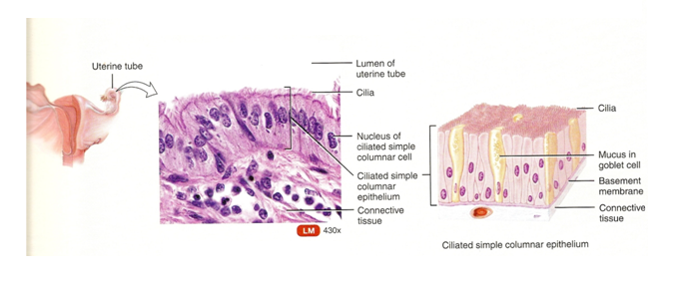
CILIATED SIMPLE COLUMNAR EPITHELIUM

Slide 39
E. PSEUDOSTRATIFIED COLUMNAR EPITHELIUM
Description :- Not a true stratified tissue; nuclei of cells are of different levels; all cells are attached to basement membrane, but not all reach the apical surface.
Location :- Pseudo stratified ciliated columnar epithelium lines the airway of most of the upper respiratory tract; pseudo stratified nonciliated columnar epithelium lines large duct of many glands, epididymis, and part of male urethra.
Function :- Secretion and movement of mucus by ciliary action.

Slide 40
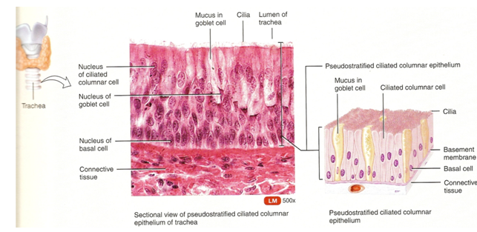
PSEUDOSTRATIFIED COLUMNAR EPITHELIUM

Slide 41
F. STRATIFIED SQUAMOUS EPITHELIUM
Description :- Several layers of cells; cuboidal to columnar shape in deep layers; squamous cells form the apical layer and several layers deep to it; cells from the basal layer replace surface cells as they are lost.
Location :- Keratinized variety forms superficial layer of skin; nonkeratinized variety lines wet surface, such as lining of the mouth, esophagus, part of epiglottis, part of pharynx, and vagina,and covers the tongue.
Function :- Protection

Slide 42
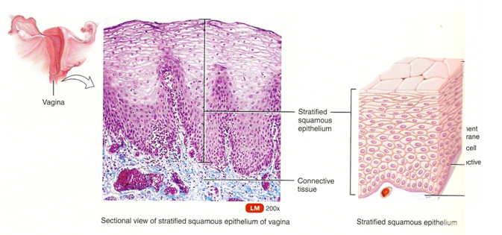
Stratified squamous epithelium

Slide 43
G. STRATIFIED CUBOIDAL EPITHELIUM
Description :- Two or more layers of cells in which the cells in the apical layer are cube-shaped.
Location :- Ducts of adult sweat glands and esophageal glands and parts of male urethra.
Function :- Protection and limited secretion and absorption.

Slide 44
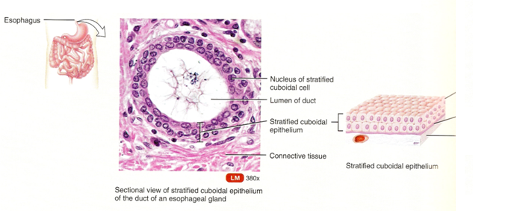
Stratified cuboidal epithelium
Apical surface
Basement membrane
Connective
tissue

Slide 45
H. STRATIFIED COLUMNAR EPITHELIUM
Description :- Several layers of irregularly shaped cells; only the apical layer has columnar cells.
Location :- Lines part of urethra, large excretory ducts of some glands, such as esophageal glands.
Function :- Protection and secretion.

Slide 46
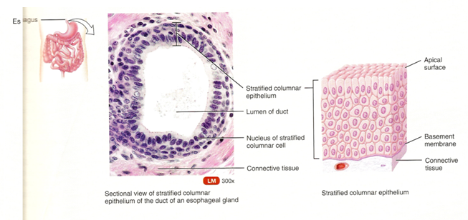
Stratified columnar epithelium

Slide 47
I. TRANSITIONAL EPITHELIUM
Description :- Appearance is variable (transitional); shape of cells in apical layer ranges from squamous (when stretched) to cuboidal (when relaxed).
Location :- Lines urinary bladder and portions of ureters and urethra.
Function :- Permits distention.

Slide 48
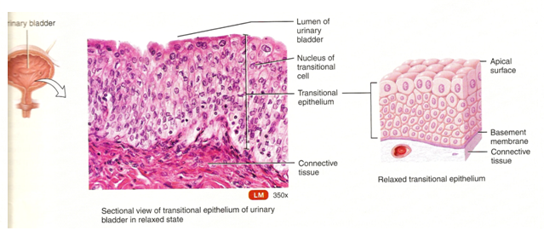
Transitional epithelium

Slide 49
A. MESENCHYME
Description :- Consists of irregularly shaped mesenchymal cells embedded in a semifluid ground substance that contains reticular fibers.
Location :- Under skin and along developing bones of embryo; some mesenchymal cells are found in adult connective tissue, especially along blood vessels.
Function :- Forms all other types of connective tissue.

Slide 50
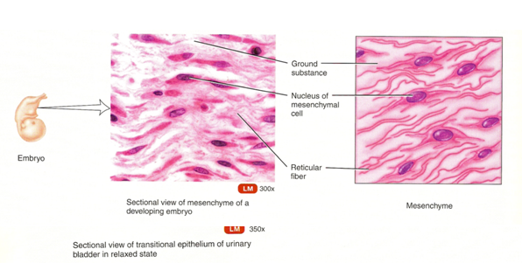
Mesenchyme

Slide 51
B. MUCOUS CONNECTIVE TISSUE
Description :- Consists of widely scattered fibroblasts embebbed in a viscous, jellylike ground substance that contains fine collagen fibers.
Location :- Umbilical cord of fetus.
Function :- Support.

Slide 52
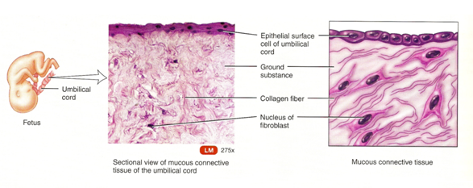
Mucous connective tissue

Slide 53
A. AREOLAR CONNECTIVE TISSUE
Description :- Consists of fibers (collagen, elastic, & reticular) and several kinds of cells (fibroblasts, macrophages, plasma cells, adipocytes, and mast cells) embedded in a semifluid ground substance.
Location :- Subcutaneous layer deep to skin; papillary (superficial) region of dermis of skin, lamina propria of mucous membranes; and around blood vessels, nerves, and body organs.
Function :- Strength, elasticity, and support.

Slide 54
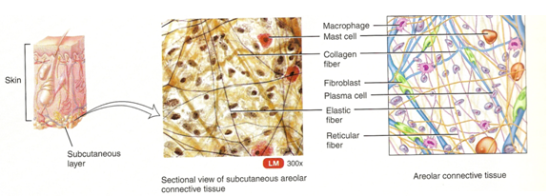
Areolar connective tissue

Slide 55
B. ADIPOSE TISSUE
Description :- Consists of adipocytes, cells specialized to store triglycerides(fats) as a large centrally located droplet; nucleus and cytoplasm are peripherally located.
Location :- Subcutaneous layer deep to skin, around heart and kidneys, yellow bone marrow, and padding around joints and behind eyeball in eye socket.
Function :- Reduces heat loss through skin, serves as a energy reserve, supports, and protects. In newborns, brown adipose tissue generates considerable heat that helps maintain proper body temperature.

Slide 56
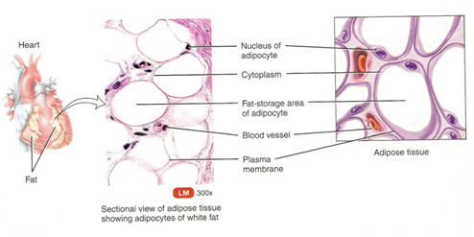
Adipose tissue

Slide 57
C. RETICULAR CONNECTIVE TISSUE
Description :- A network of interlacing reticular fibers and cells.
Location :- Stroma(supporting framework) of liver, spleen, lymph nodes; red bone marrow, which gives rise to blood cells; reticular lamina of the basement membrane; and around blood vessels and muscles.
Function :- Forms stroma of organs; binds together smooth muscle tissue cells; filters and removes worn-out blood cells in the spleen and microbes in lymph nodes.

Slide 58
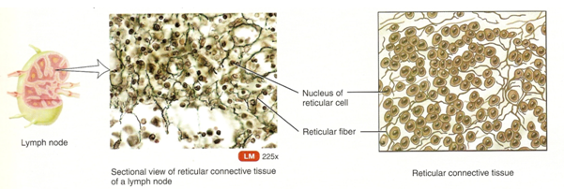
Reticular connective tissue

Slide 59
D. DENSE REGULAR CONNECTIVE TISSUE
Description :- Extracellular matrix looks shiny white; consists mainly of collagen fibers arranges in bundles; fibroblasts present in rows between bundles.
Location :- Forms tendons, most ligaments, and aponeurosis.
Function :- Provides strong attachment between various structures.

Slide 60
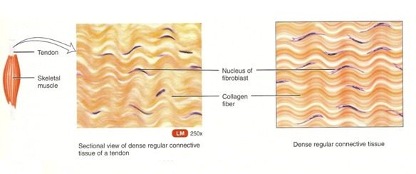
Dense regular connective tissue

Slide 61
E. DENSE IRREGULAR CONNECTIVE TISSUE
Description :- Consists predominantly of randomly arranged collagen fibers and a few fibroblasts.
Location :- Fasciae, reticular region of dermis of skin, periosteum of bone, perichondrium of cartilage, joint capsules, membrane capsules around various organs (kidney,liver,testes, lymph nodes), pericardium of the heart, and heart valves.
Function :- Provides strength.

Slide 62
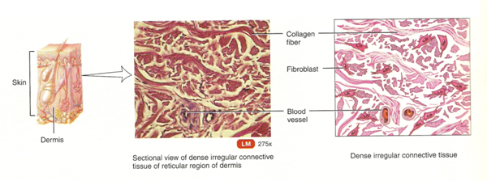
Dense Irregular C.T.

Slide 63
F. ELASTIC CONNECTIVE TISSUE
Description :- Consists predominantly of freely branching elastic fibers; fibroblasts are present in space between fibers.
Location :- Lung tissue, walls of elastic arteries, trachea, bronchial tubes, true vocal cords, suspensory ligament of penis, and ligaments between vertebrae.
Function :- Allows stretching of various organs.

Slide 64
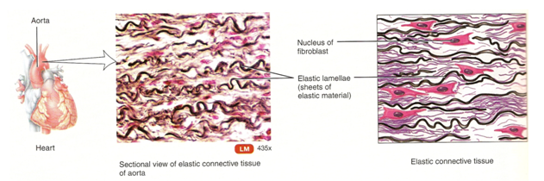
Elastic connective tissue

Slide 65
G. HYALINE CARTILAGE
Description :- Consists of a bluish-white, shiny ground substance with fine collagen fibers and many chondrocytes; most abundant type of cartilage.
Location :- Ends of long bones, anterior ends of ribs, nose, parts of larynx, trachea, bronchi, bronchial tubes, and embryonic and fetal skeleton.
Function :- Provides smooth surfaces for movements at joints, as well as flexibility and support.

Slide 66
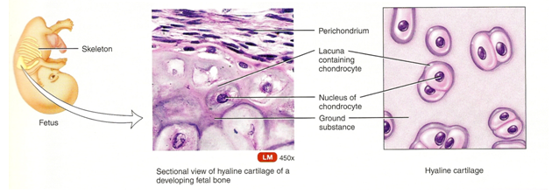
Hyaline Cartilage

Slide 67
H. FIBROCARTILAGE
Description :- Consists of chondrocytes scattered among bundles of collagen fibers within the extracellular matrix.
Location :- Pubic symphysis, intervertebral discs, menisci of knee, and portions of tendons that insert into cartilage.
Function :- Support and fusion.

Slide 68
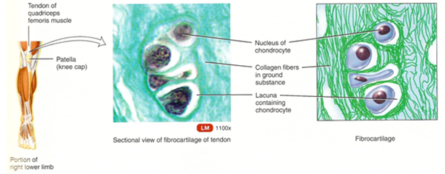
Fibrocartilage

Slide 69
I. ELASTIC CARTILAGE
Description :- Consists of chondrocytes located in a threadlike network of elastic fibers within the extracellular matrix.
Location :- Lid on top of larynx, part of external ear, and auditory tubes.
Function :- Gives support and maintains shape.

Slide 70
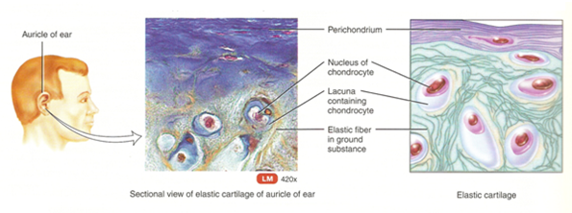
Elastic cartilage

Slide 71
J. COMPACT BONE
Description :- Compact bone tissue consists of osteons that contain lamellae, lacunae, osteocytes, canaliculi, and central canals. By contrast, spongy bone tissue consists of thin columns called trabeculae; spaces between trabeculae are filled with red bone marrow.
Location :- Both compact and spongy bone tissue make up the various parts of bones of the body.
Function :- Support, protection, storage; houses blood-forming tissue; serves as levers that act with muscle tissue to enable movement.

Slide 72
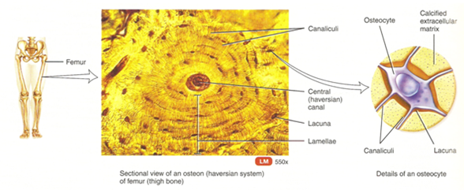
Compact bone

Slide 73
K. BLOOD
Description :- Consists of blood plasma and formed elements; R.B.C.(erythrocytes), W.B.C.(leukocytes), and platelets(thrombocytes).
Location :- Within blood vessels and within the chambers of the heart.
Function :- Red blood cells transport oxygen and some carbon dioxide; W.B.C. carry on phagocytosis and are involved in allergic reactions and immune system responses; platelets are essential for the clotting of blood.

Slide 74
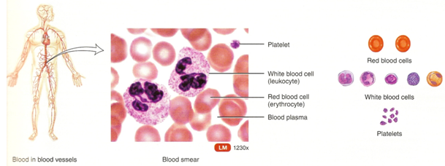
Blood

Slide 75
A. SKELETAL MUSCLE TISSUE
Description :- Long, cylindrical, striated fibers with many peripherally located nuclei; voluntary control.
Location :- Usually attached to bones by tendons.
Function :- Motion, posture, heat production, and protection.

Slide 76
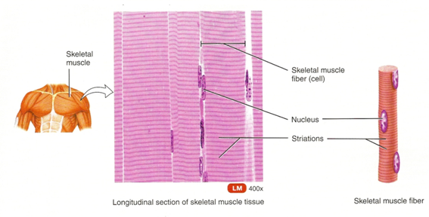

Slide 77
B. CARDIAC MUSCLE TISSUE
Description :- Branched striated fibers with one or two centrally located nuclei; contains intercalated discs; involuntary control.
Location :- Heart wall.
Function :- Pumps blood to all parts of the body.

Slide 78
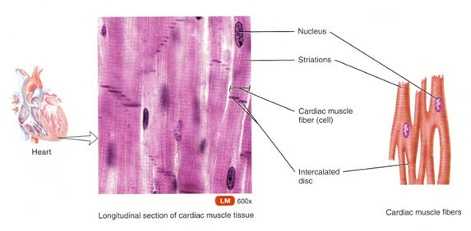

Slide 79
C. SMOOTH MUSCLE TISSUE
Description :- Spindle-shaped, nonstriated fibers with one centrally located nucleus; involuntary control.
Location :- Iris of the eye, walls of hollow internal structures such as blood vessels, airways to the lungs, stomach, intestines, gallbladder, urinary bladder, and uterus.
Function :- Motion(constriction of blood vessels and airways, propulsion of foods through G.I.T., contraction of urinary bladder and gallbladder).

Slide 80
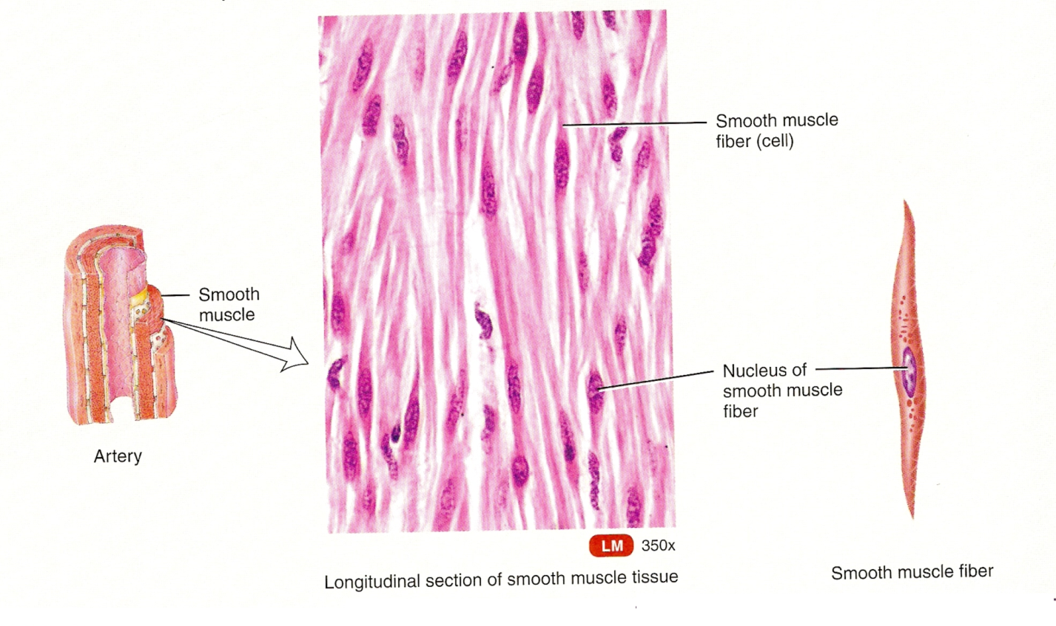

Slide 81
NERVOUS TISSUE
Description :- Consists of neurons and neuroglia. Neurons consist of a cell body and processes extending from the cell body(multiple dendrites and a single axon).Neuroglia do not generate or conduct nerve impulses but have other important supporting functions.
Location :- Nervous system.
Function :- Exhibits sensitivity to various types of stimuli, converts stimuli into nerve impulses, and conducts nerve impulses to other neurons, muscle fibers, or glands.

Slide 82
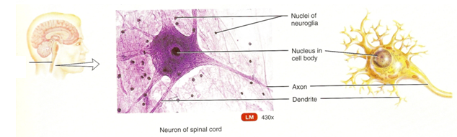
Spinal
cord

Slide 83

THE ORGAN SYSTEM
OF
HUMAN BODY

Slide 84
CONTENTS
Definition of organ system
Different organ systems
Functions

Slide 85
Definition
The structural organization in the body is the system, also called the organ-system. A system consist of related organs with common function.

Slide 86
Different organ systems
  Integumentary System
  Skeletal System
  Muscular System
  Nervous System
  Endocrine System
  Lymphatic System
  Cardiovascular System
  Respiratory System
  Digestive System
  Urinary System
  Reproductive System

Slide 87
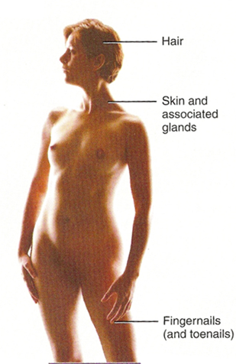
Integumentary System

Slide 88
Integumentary System (in-teg-u-MEN-tar-e ; inte- =Whole; -gument = body covering).
The medical specialty that deals with the diagnosis and treatment of integumentary system disorders is known as Dermatology (der’-ma-TOL-o-je ; dermato- = skin ; -logy=study of).
Components : Skin, and structures derived from it, such as hair, nails, sweat glands, and oil glands.
Functions :
Protects the body.
Helps in regulation of body temperature.
Helps in absorption of vitamin D.
Also detects sensations such as touch, pain, warmth, and cold.

Slide 89
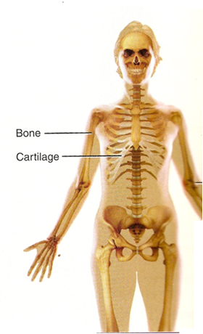
  Skeletal System
Joint

Slide 90
Skeletal System – The entire framework of bones and their cartilages.
The study of bone structure and the treatment of bone disorders is called Osteology (os-te-OL-o-je; osteo- = bone; -logy = study of).
Components : Bones and joints of the body and their associated cartilages.
Functions :
Supports and protects the body.
Provides a surface area for muscle attachments and aids body movements.
Houses cells that produce blood cells and stores minerals and lipids.

Slide 91
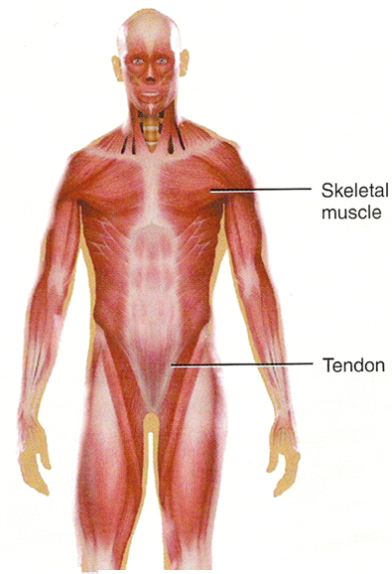
Muscular System

Slide 92
Muscular System - The voluntarily controlled muscles of our body comprise this system.
Components : Muscles composed of skeletal muscle tissue, so – named because it is usually attached to bones.
Functions :
Produces body movement, such as walking.
Stabilizes body position(posture) and also generates heat.

Slide 93
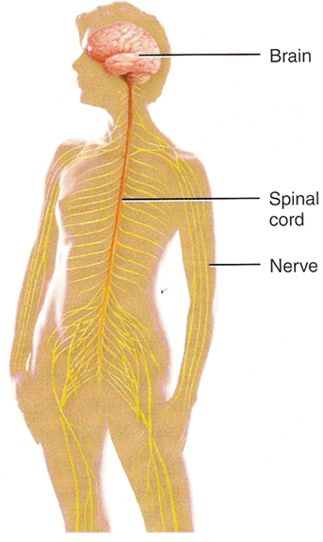
  Nervous System

Slide 94
The branch of medical science that deals with the normal functioning and disorders of the nervous system is Neurology (noo-ROL-o-je ; neuro = nerve or nervous system ; -logy = study of).
Components : Brain, spinal cord, nerves, and special sense organs, such as the eyes and ears.
Functions :
Generates action potentials to regulate body activities.
Detects changes in the body’s internal and external environment.
Interprets the changes, and responds by causing muscular contractions or glandular secretions.

Slide 95
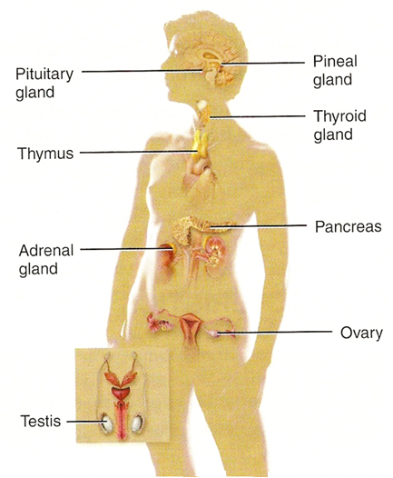
Endocrine System

Slide 96
Endocrine System
In this system we study about the hormones and how they control body functions. Study of endocrine system is called Endocrinology (en’-do-kri-NOL-o-je ; endo = within ; -crin =secretion)
Components : Hormone-producing glands (pineal gland, hypothalamus, pituitary gland, thymus, thyroid gland, parathyroid glands, adrenal glands, pancreas, ovaries, and testes) and hormone-producing cells in several other organs.
Functions :
Regulates body activities by releasing hormones, which are chemical messengers transported in blood from an endocrine gland to a target organ.

Slide 97
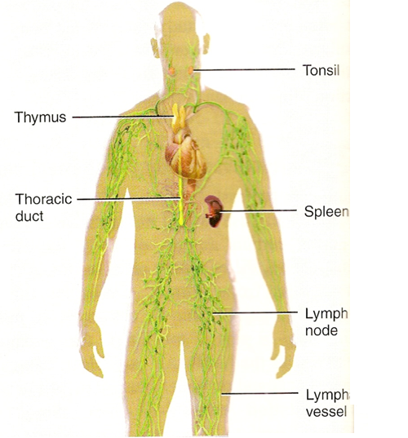
Lymphatic System & Immunity
atic

Slide 98
The lymphatic system (lim-FAT-ik) consists of a fluid called lymph(LIMF = clear fluid), and vessels called lymphatic vessels that transport the lymph.
Immunity means the ability of the body to defend itself against specific invading agents such as bacteria, toxins, viruses, and foreign tissues.
The branch of science that deals with the responses of the body when challenged by antigens is called immunology (im’- u – NOL – o- je ; immuno- = free from service ; -logy = study of).
Components : Lymphatic fluid and vessels; also includes spleen, thymus, lymph nodes, and tonsils.
Functions :
Returns proteins and fluid to blood.
Carries lipids from G.I.T. to blood.
Includes structures where lymphocytes that protect against disease-causing microbes mature and proliferate.

Slide 99
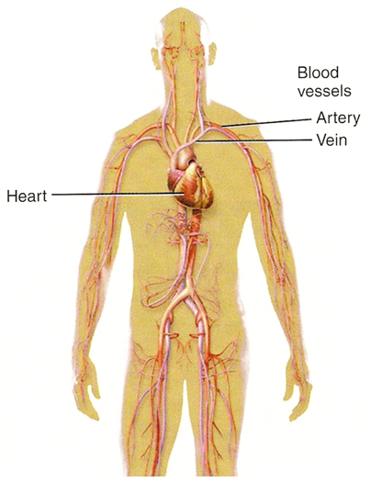
Cardiovascular System

Slide 100
The cardiovascular system (kar–de–o- VAS-ku-lar ; cardio = heart ; vascular = blood vessels ) consists of three interrelated components : blood, the heart, and blood vessels.
The branch of science concerned with the study of blood, blood-forming tissues, and the disorders associated with them is hematology (hem – a – TOL – o- je ; hema- or hemato- = blood ; -logy = study of).
Components : Blood, heart, and blood vessels.
Functions :
Heart pumps blood through blood vessels.
Blood carries oxygen and nutrients to cells and carbon dioxide and waste away from cells and helps regulate acid-base balance, temperature, and water content of body fluids.
Blood components help defend against disease and mend damaged blood vessels.

Slide 101
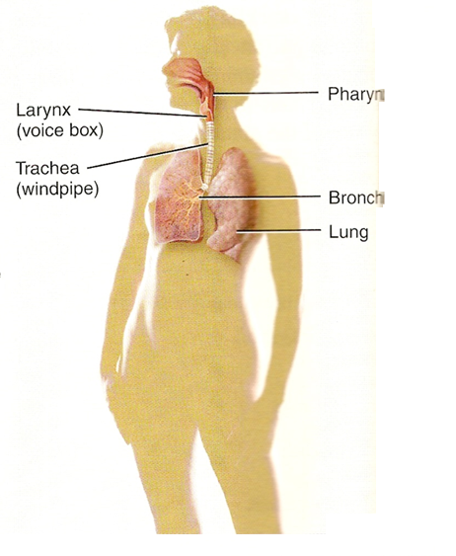
Respiratory System

Slide 102
The respiratory (RES – pir- a- to’- re ; respira = to breathe) system consists of the nose, pharynx (throat), larynx (voice box), trachea (windpipe), bronchi, and lungs.
The branch of medicine that deals with the diagnosis and treatment of diseases of the ears, nose, and throat (ENT) is called otorhinolaryngology (o’- to – ri’- no – lar’- in – GOL – o – je ; oto- = ear; rhino- = nose; laryngo- = voice box; -logy = study of).
Components : Lungs and air passageways such as pharynx, larynx, trachea, and bronchial tubes leading into and out of them.
Function :
Transfers oxygen from inhaled air to blood and carbon dioxide from blood to exhaled air.
Helps regulate acid-base balance of body fluids.
Air flowing out of lungs through vocal cords produces sounds.

Slide 103
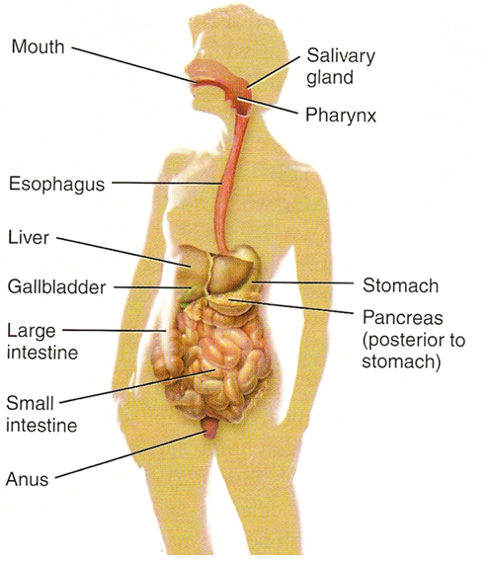
Digestive System

Slide 104
Food must be broken down into molecules that are small enough to enter body cells, a process known as digestion. The organ involved in the breakdown of food are collectively known as the digestive system.
The medical specialty that deals with the structures, function, diagnosis, and treatment of disease of the stomach and intestines is called gastroenterology (gas’-tro - en’- OL – o- je ; gastro- = stomach; entero- =intestines ; -logy = study of).
Components : Organs of G.I.T., a long tube includes the mouth, pharynx, esophagus, stomach, small and large intestines, anus; also includes accessory organs that assist in digestive process, such as the salivary glands, liver, gallbladder, and pancreas.
Functions :
Achieves physical and chemical breakdown of food.
Absorbs nutrients and eliminates solid wastes.

Slide 105
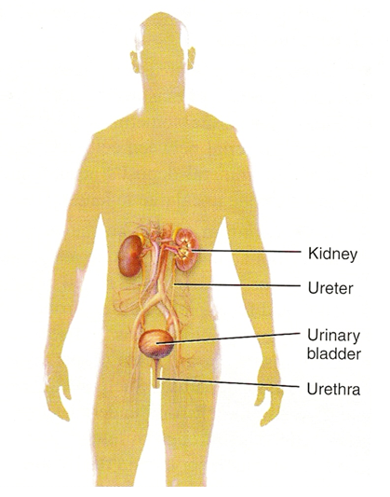
Urinary System

Slide 106
The urinary system consists of two kidneys, two ureters, one urinary bladder and one urethra . The scientific study of the anatomy, physiology and pathology of kidneys is called Nephrology (nef-ROL-o-je; nephr- =kidney; -ology=study of).
The branch of medicine that deals with the male and female urinary systems and the male reproductive system is called urology (u-ROL-o-je; uro- =urine).
Components : Kidneys, ureters, urinary bladder, and urethra.
Functions :
Produces, stores, and eliminates urine.
Eliminates waste and regulates volume and chemical composition of blood.
Helps maintain the acid-base balance of body fluids.
Maintains body’s mineral balance and helps in regulate production of red blood cells.

Slide 107
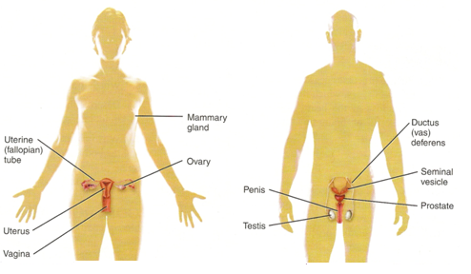
Reproductive System

Slide 108
Sexual reproduction is the process by which organisms produce offspring by making germ cells called gametes (GAM-ets=spouses).
Components : Gonads and associated organs (uterine tubes, uterus, and vagina in females and epididymis, ductus deferens and penis in males).
Functions :
Gonads produce gametes that unite to form a new organisms.
Gonads also release hormones that regulate reproduction and other body processes.
Associated organs transport and store gametes.

